Slide 1
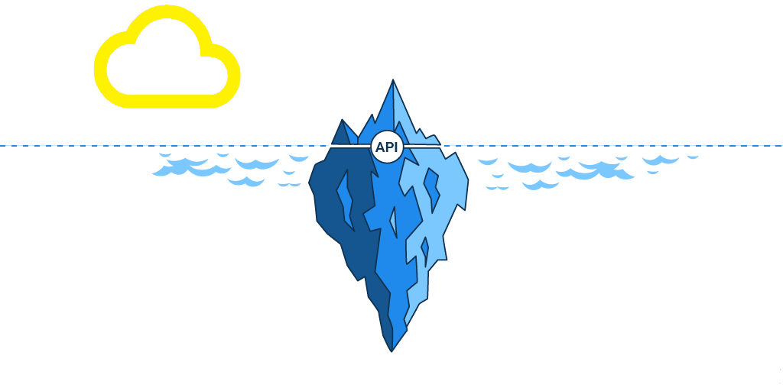

Front-End
Back-End

Slide 2











Server
JSON
Request
Front-End
API
Back-End
E
T
L

Slide 3
API Routs
Input Routs:
4 APIs To be used in the web application’s interactive tools:
/api/v1.0/years
/api/v1.0/countries
/api/v1.0/regions /api/v1.0/admission_classes
Data Routs:
5 APIs to be provide data for JS visualizations:
api/v1.0/migration_data/(demography)
/api/v1.0/immigrants_by_county/(countries or regions)/(years)/(top)
/api/v1.0/immigrants_by_state/(countries or regions)/(years)/(top)
/api/v1.0/diversity_by_state/(locations)/(years)/(top)
Notes:
1 min

Slide 4
Immigrants’ demographics Data
To extract multiple demographics data from the database:
api/v1.0/migration_data/
Demography
Age
Education
Income
Median Income
Income
Occupation
Notes:
1 min

Slide 5
Immigrants’ distribution data
To extract immigrants’ distribution information throughout the USA.
The APIs are designed to the user a variety of options to make customized query.
/api/v1.0/immigrants_by_county/
countries or regions
/years/
/top
/api/v1.0/immigrants_by_state/
Mexico
2010
5
Mexico&India
2010&2015
n
region:Europe
2008:2015
all
all
all
Notes:
1 min

Slide 6
State’s Immigrants diversity
To extract immigrants’ diversity data by state
/api/v1.0/diversity_by_state/
Location
/years/
/top
California
2010
5
Texas
2010&2015
n
all
2008:2015
all
all

